Slide 1

Building Smarter Deals in a Fragmented World
Balagopal Ravibalan
September 2025

Slide 2

Complexity Isn’t Tangled.
It’s Expertly Twisted.
Notes:
A German pretzel looks intricate.
Twisted, looped, seemingly complex. But every turn is intentional. Every knot serves a purpose.
The same goes for building smart banking deals.
Multinational clients. Regulatory threads. Real-time pricing. They may seem tangled - but with the right design, they form something elegant, efficient, and universally appreciated.
Complexity doesn’t have to be chaotic. It can be structured. Deliciously so.
You know, bakers in Germany take years to master the perfect twist of a pretzel. One wrong move and the whole shape collapses.
Funny thing - structuring a cross-border banking deal isn’t that different. It’s not about avoiding complexity. It’s about embracing it with the right structure. And that’s what we’ll unpack today

Slide 3

The Challenges in Global Corporate Banking
67%
of corporate banks are prioritizing “streamlined, end-to-end processes” as their top transformation agenda through 2026 (BCG, 2024)
Fragmentation
Silos
Client Demand
Cross-border complexity, multi-currency dynamics, regulatory divergence
Lack of unified processes across geographies, lines of business, and product silos
Multinationals expect fast, tailored, and transparent offers—everywhere
65%
of corporates rate “real-time transparency” on cross-border payments as critical, yet over half are dissatisfied with current levels (SWIFT, 2024)
55%
of multinationals choose providers based on the ability to offer tailored solutions in new markets (EY Global Corporate Banking Survey, 2024)

Slide 4

What is holding them back…
Challenge
Business Impact
1
Fragmented client propositions,
slow cycles, errors
Siloed systems/ Manual processes
2
Revenue leakage, inconsistent offers, lack of traceability
Disjointed pricing mechanisms
3
Bottlenecks, delays, higher operational risk
Legacy approvals
4
Unchecked benefits, policy inconsistencies
Compliance fragmentation

Slide 5
The Imperative: Intelligent, Unified Deals
Precision
Why Leaders Are Transforming Deal Management
Every term, rate, and risk metric must be contextual and accurate
Speed
Time-to-offer is a new source of competitive advantage
Edge through precision: Speed, context, and control drive growth
True customer centricity: Engage holistically, not transactionally
Global orchestration: Margin protection + compliance = sustainable scale
Intelligence
Decisions powered by real-time data across products, borders, and teams
Governance
Embedded controls ensure transparency, compliance, and accountability at every step

Slide 6

Technology: The New Connective Tissue
Seamlessly link entities, products, and geographies
Orchestrate real-time data: customer, risk, market
Deliver unified, responsive global deals
Enable dynamic, data-driven proposals with precision
Comprehensive approval and governance framework

Slide 7

The Ai-augmented Deal Management
Informed Decisioning: Advanced recommendations based on AI models
Dynamic Pricing: Offer optimal pricing guided by pricing rules, customer profiles, market intelligence, and profitability thresholds
Real-time Simulation: Model complex, multi-product deals instantly for revenue and profitability
Automated Compliance: Apply jurisdiction-specific norms and rules instantly
Smart Workflows: Route for approvals and exceptions with minimal friction
Proactive Tracking: Track commitments and performance of deals to prevent revenue leakage
BUILT-IN GOVERNANCE AND RISK CONTROL
Full auditability: Transparent approvals, decisions, and escalations
Rule-based workflows: No delays—just intelligent, compliant flow
Policy alignment: Global consistency with local agility

Slide 8





Let’s Look at a Use Case
A global corporate seeks Banking services across their ops in Germany, Dubai, and Singapore
The sales officer automatically converts the RFP issued by the corporate into a deal structure using AI
Dynamic pricing tailors each proposition to balance local and group-level priorities
Automated workflows enable same-day proposal turnaround
Compliance captured via automated audit trail across jurisdictions

Slide 9

Future-ready Capabilities
Higher win rates, stronger client alignment
Visibility and control across deal stages
Accuracy, speed, and auditability
Guided decisions, smart recommendations
Strategic Value
Capability
End-to-end deal management
AI assistants
SEGMENT of ONE offerings
Real-time dashboards

Slide 10
Next Frontier: From Automation To Autonomy
Generative AI Assistants
Digital self-service
Adaptive learning
Conversational Deal Construction
Summarize, suggest, and simulate in real time
Let premium clients design their own deals
Evolve with market signals and client behavior
Use prompt-based AI to craft deals through natural language interactions

Slide 11

Tangible Business Outcomes
Revenue Optimization
Plugged 20% leakage for a top European bank
Value Creation
300% ROI achieved through pricing transformation for a leading Asian bank
Speed to Market
83% faster time to market for a leading regional bank

Slide 12


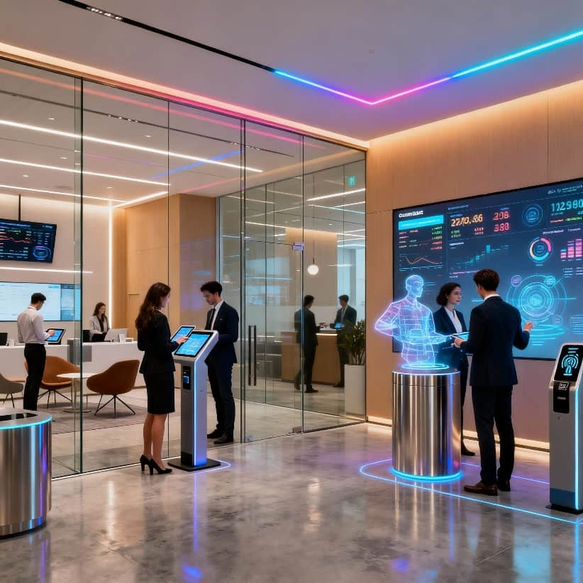

Summary: The Era Of Smarter Deals
Manual, fragmented
deal-making is obsolete
Banks that adapt will lead in value, agility, and client trust
The future is orchestrated, intelligent, and
real-time

